Slide 1
Tech Talk: Forecasting for dummies
David starkey
Thursday 24th January 2019

Slide 2
Contents
Forecasting motivation… applications
Universal ingredients for forecasting models
Trends
Seasonality
Additional information (lags/correlation… e.g flows → arbs)
Noise
Inspiration from astronomy
Application to Vortexa

Slide 3
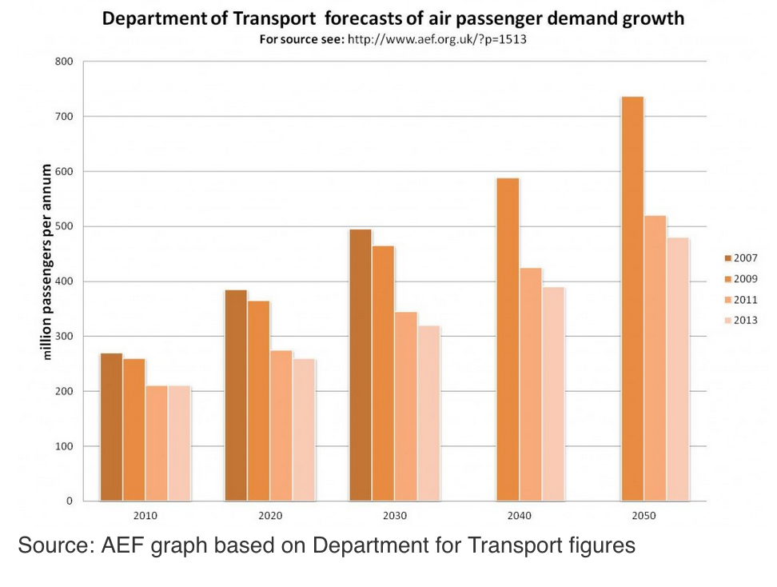
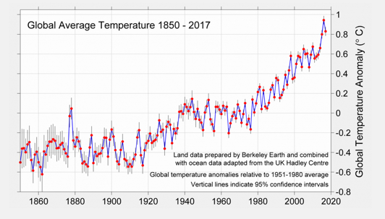
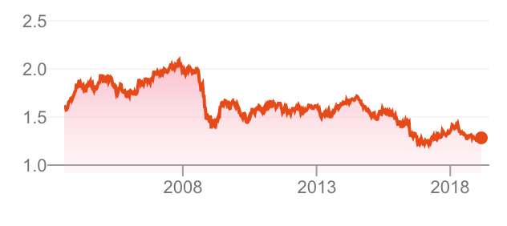
Motivation – what is a time series and a forecast?
Any quantity with measurements multiple historic measurements is a time series.
A forecast happens when a model is fitted to the historic time series and extrapolated into the future.
Present everywhere in all fields! – Climate, econometrics, social sciences, operational research…
Climate Data
Pound to dollar

Slide 4
Universal ingredients for forecasting models
Background component
Trend component
Seasonal component
Noise
Other (lags, auto-correlation etc)

Slide 5
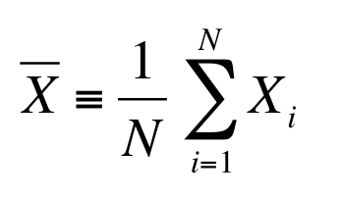
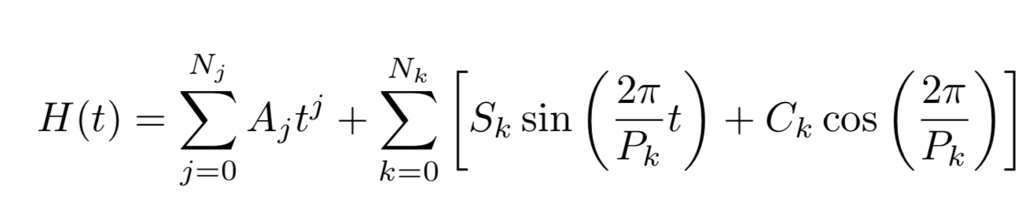
Universal Ingredients 1 –Background component
Residue
Data - Model

Slide 6
Universal Ingredients 2 - Trend
Residue (Data – Model)

Slide 7
Universal Ingredients 3 - Seasonality
Residue (Data – Model)

Slide 8
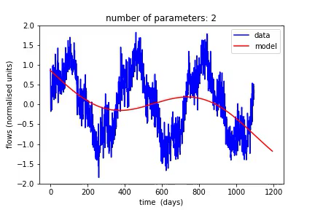

Overfitting – seasonality example
How many frequency components to include (1-year, 6-month, 3-month, 1-month etc)?
Model is able to reproduce the variations in the data as more components are included.
Eventually the model overfits the data and begins to fit noise rather than true seasonality.

Slide 9
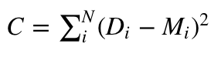
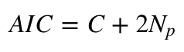
Optimal number of components
Model parameters traditionally optimized by minimizing a least-squares cost function.
We can update this to favour solutions with fewer parameters by minimizing the least-square sum plus a penalty for large numbers of parameters (the AIC).

Slide 10
Universal ingredients for forecasting models
Background component – mean, median etc
Trend component –
Seasonal component –
Noise
Other (lags, auto-correlation etc)

Slide 11
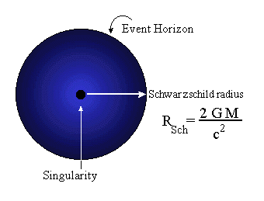
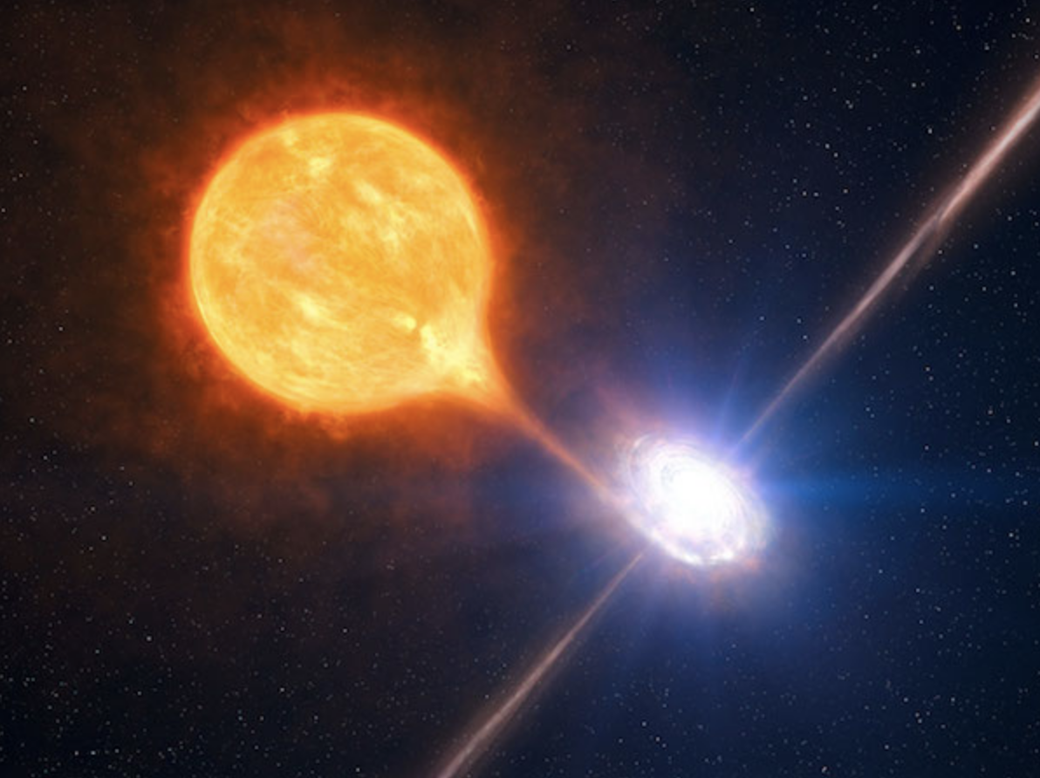
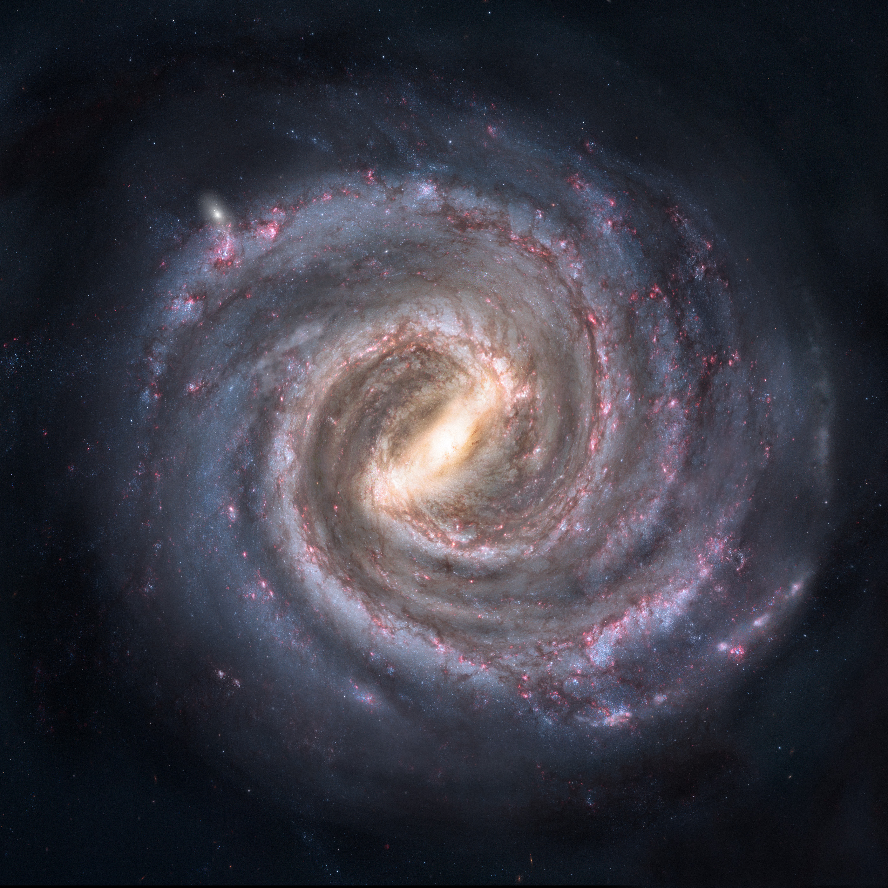
Black Holes
Can be theoretically an size.
Anything whose mass is sufficiently condensed such that all of it is contained within its Schwarzschild radius
In practice, they come in two sizes…
Stellar mass
(~ 20 time the mass of the sun)
Supermassive
(1 million → 1 billion solar masses)

Slide 12
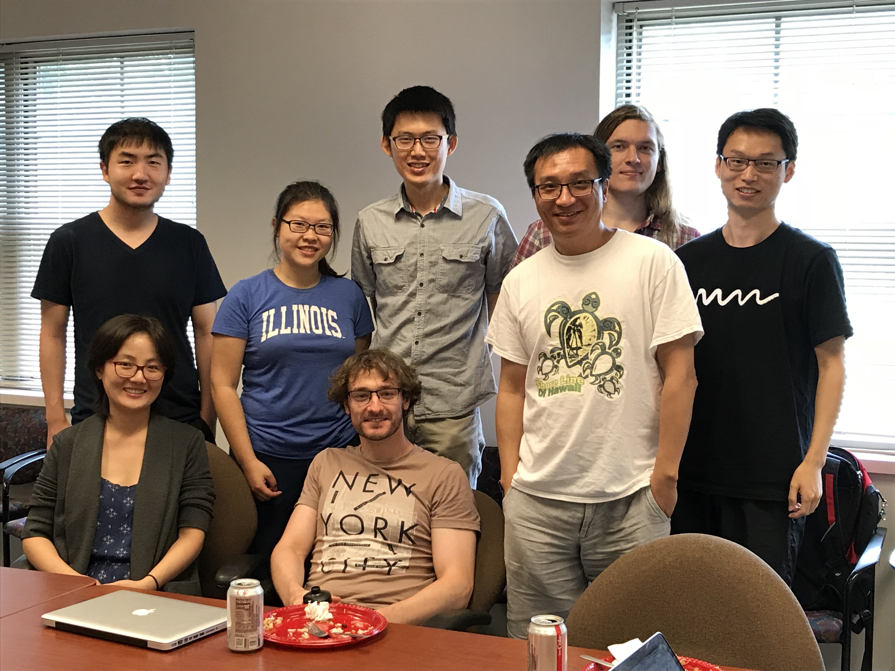





Time Variability in Active Galactic Nuclei: What it tells us
David Starkey
In collaboration with Keith Horne, Yue Shen, J Li & the sloan digital sky survey project
Notes:
Milky way – gas – dust –stars -Earth
Black holes lie at the centre of all galaxies and sometimes, they are feeding
Top: - Carina Nebula, an immense cauldron of gas and dust that lies approximately 7500 light-years from Earth in the constellation of Carina, the Keel.
Bot: - 3c273 Quasar (bright AGN).
Point: difficult in early 20th century to distinguish the spectra of stars from AGN.

Slide 13
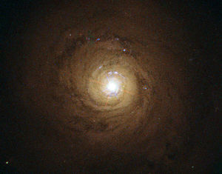
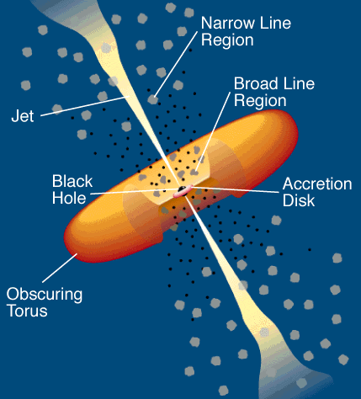
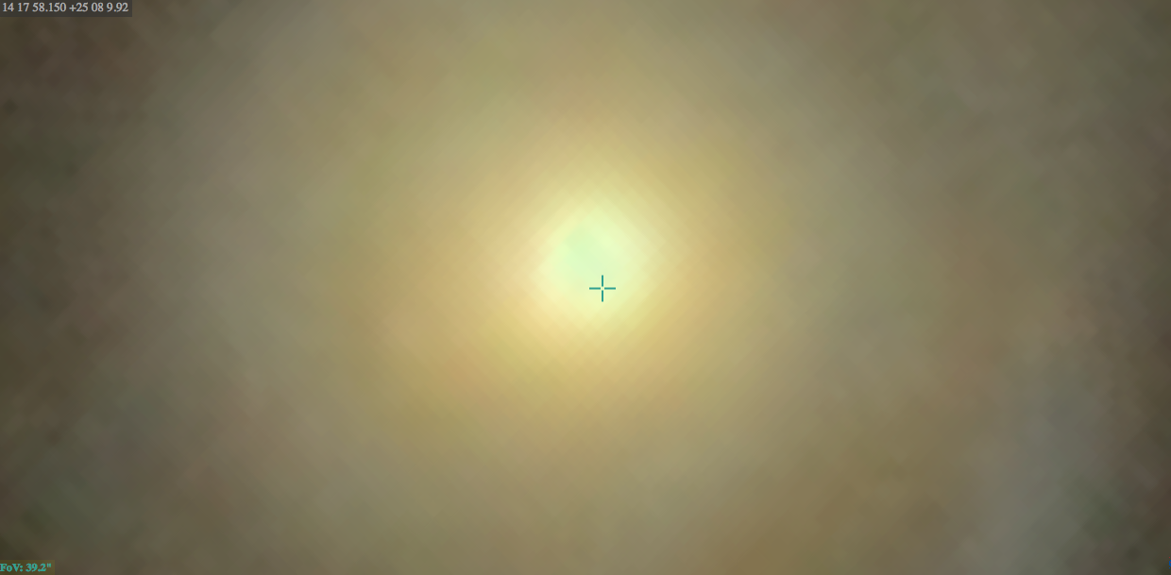
Active Galaxies
Emit radiation from a source other than the stars and gas in the galaxy.
The nuclei (AGN) contain a black hole (10⁷ -10⁹ M_{o}), accretion disc, and gas orbiting at 10’s to 1000’s of light days (ld) surrounded by a dusty torus. – 1ld = 2.6 x 10¹³m
~1000 ld
1.25x10⁷ ld
5x10⁷ light days (ld)
[Urry and Padovani 1995]
[SDSS]
[SDSS]
Notes:
Active galactic nuclei (AGN) are among the most pow-
erful sources of energy in the Universe, where the bright-
est quasars can outshine all of the stars in their host
galaxy by 100 times.
Big line left (H alpha), 2nd moderate peak – Ca2, next (not double spike) Si, next He2, tall one on right (He1)
1pc ~ 1000 Light days
Show diagram of various components of AGN with relative size scales.
. Draw a circle around accretion disc bit and say (‘I live in this part of the AGN’)

Slide 14
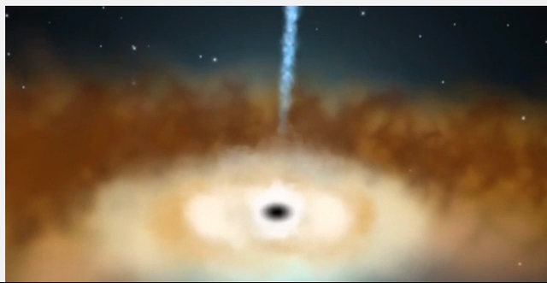
Inner-most light day (about the size of the solar system)

Slide 15
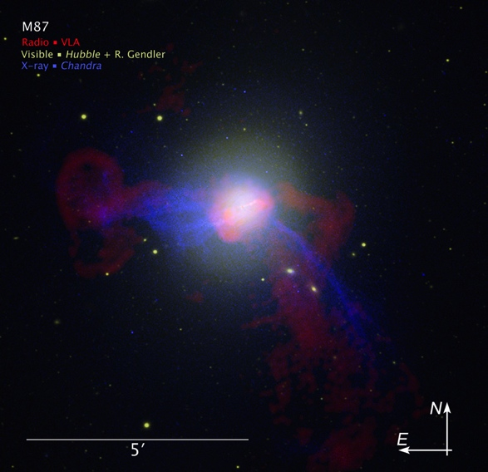
What Size Telescope is Needed to Resolve the Accretion Disk?
For a 10⁸ M_{sun} black hole, most accretion disc emission emitted within ~10 light days (LD).
R
θ
d_{M87}
Radio – VLA
Visible – HST
X-ray - Chandra
For M87 (nearby AGN), d_{M87}=5.2 x 10⁷ Lyr (~1.7 x 10¹⁵ ld)
Θ= 1.2 nano arcseconds
Telescope Diameter…
~ 30,000 km
Notes:
Recipe for working out the telescope size given a required resolution…

Slide 16

Resolution Problem
Notes:
ESO proposed an Overwhelmingly Large Teleescope but was scrapped several years ago because of overwhelmingly large buget
ELVES earth shatteringly large very enormous super telescope

Slide 17
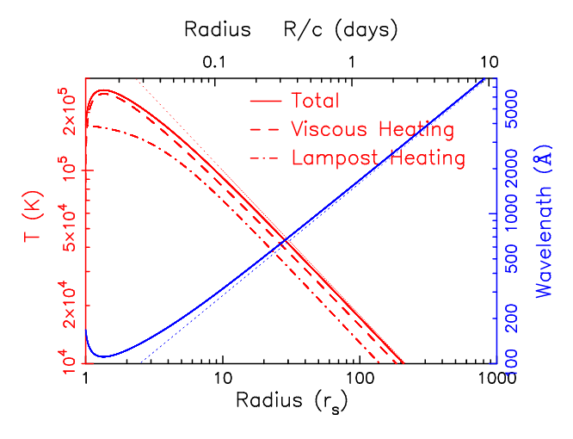
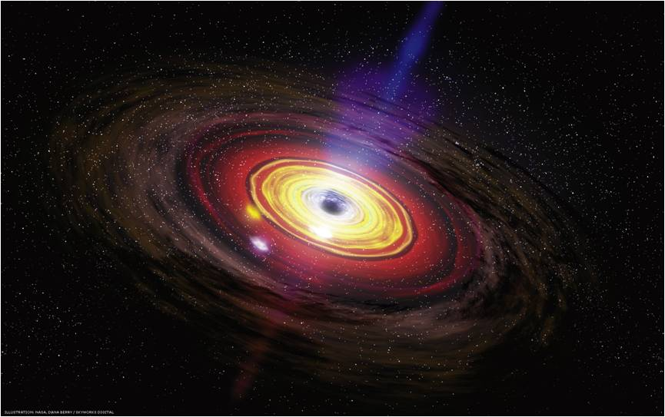
Accretion disc temperature stratification
Variations appear closer to the black hole and propagate out at light speed
Hot → Cold
Notes:
Chop disc up into discrete reprocessing site and observe time delays like with broad lines

Slide 18
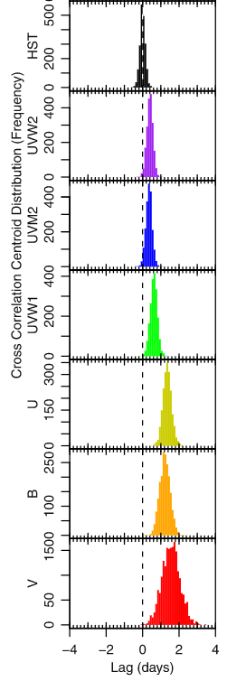
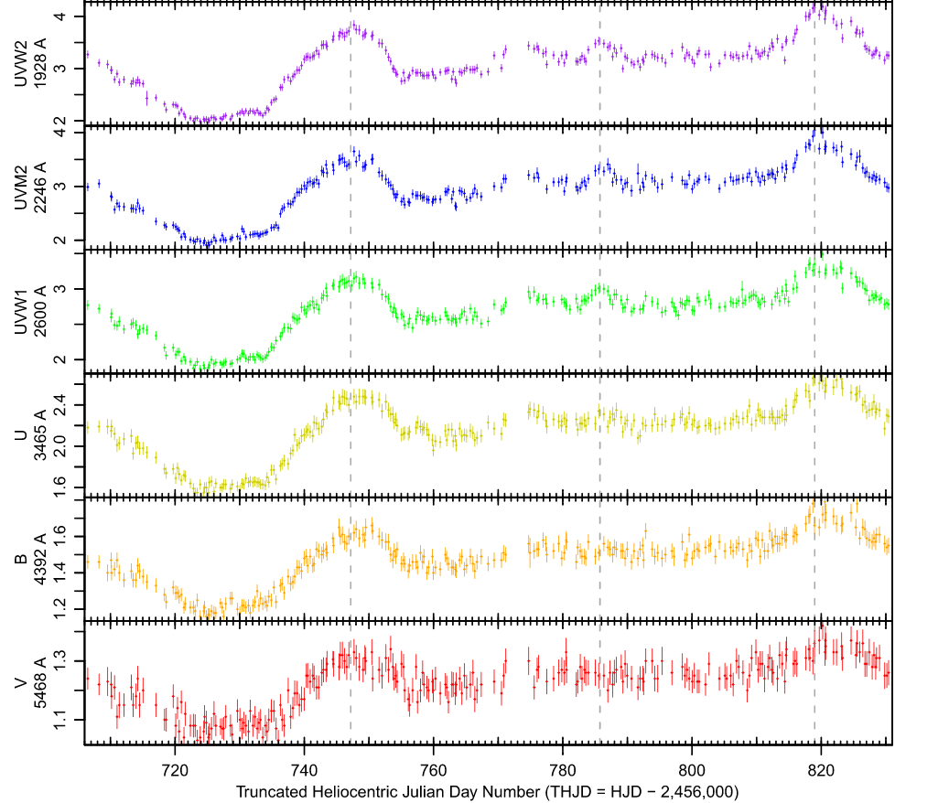
AGN Continuum Lags in NGC 5548
Time lags are measurable. What do they mean for the accretion disc.
Notes:
Time lags up to several days between the HST 1368A and V band.

Slide 19
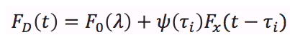
Origins of Variability: A First Order Approach?
Hot inner accretion drives variability.
Model as a point source for speed and simplicity.
F_{x}(t)
τ_{D}
Delay Distribution ψ(τ )
F_{x}(t)
τ_{D}
F_{D}(t)
F_{D}(t)
Delay (τ)
Time
observer
Notes:
SAY LAMPPOST ALOT
Expect longer wavelength light curves – longer delays – come from cooler regions of the disc -- emitting at larger radii

Slide 20
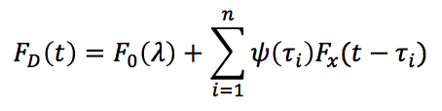
Several Discrete Reprocessing Sites
To Observer
Delay Distribution ψ(τ )
F_{x}(t)
τ_{D}
i = 1
i = 4
Delay (τ)
i = 2
i = 3
Notes:
Slightly more complex is if we have a set of discrete reprocessing sites. The total reponse from the disk then becomes a sum

Slide 21
Several Discrete Reprocessing Sites
To Observer
Delay Distribution ψ(τ )
F_{x}(t)
τ_{D}
i = 1
i = 4
Delay (τ)
i = 2
i = 3
Notes:
Slightly more complex is if we have a set of discrete reprocessing sites. The total reponse from the disk then becomes a sum

Slide 22
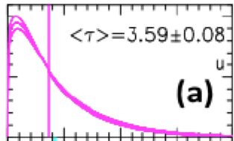
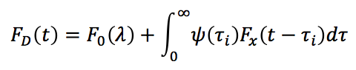
Accretion Disk Time Delays – Full Treatment
F_{x}(t)
ψ(τ|λ )
F_{D}(t)
Delay τ
<τ>
Time (days)
Evaluate numerically
Notes:
Increasing to a continuum of points, continuous disk, we replace the sum by an integral (convolution integral)
. response function very important (will be talking a lot about it) and will now spend a few slides discussing how it is affected by the disc geometry.
. Being able to fit a model that includes the full shape of the response much better than just having a a single delay (response function includes all the geometry of the disc).

Slide 23
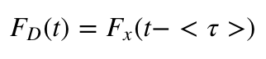
Measuring lags
Pros
Cons
Maximum information on the accretion disc (temperature, black hole accretion rate, vertical structure)
VERY computationally slow
Fit the full accretion disc model.
Compute the light curve cross correlation function
Use an auto regressive technique…
Fast, simple, fewer assumptions
Limited information on accretion disc (only average lag available NO lag distribution)
Best of both worlds….
Optical
X-rays

Slide 24
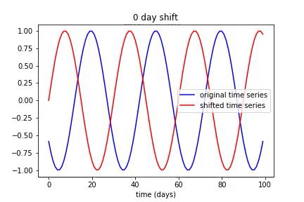
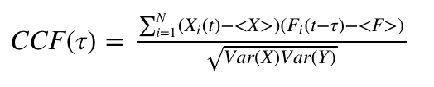
Measuring lags using cross correlation
Consider two time series signals.
Measure a lag by shifting one signal pixel by pixel and multiplying together the original and shifted time series.

Slide 25
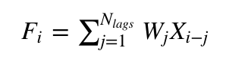
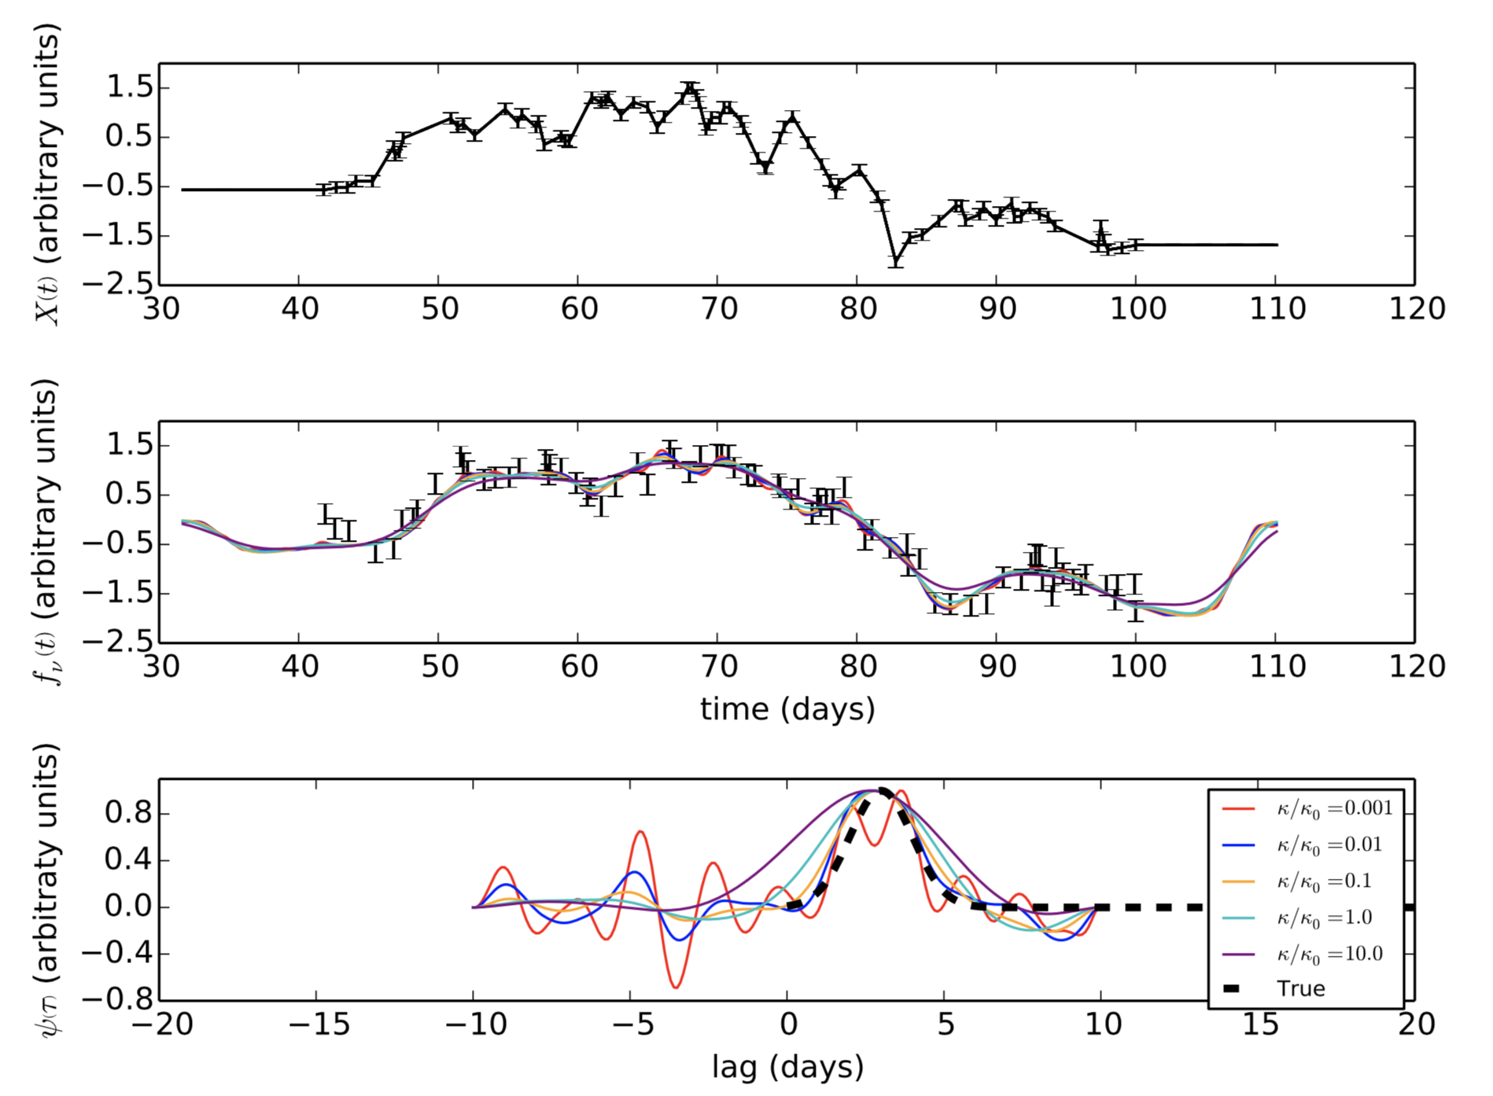
Auto regressive model
Computationally fast
Able to recover spread of time lags at different delays (CCF just gives a mean)
No hard and fast way to decide how many look back times to consider. Need to be careful to avoid overfitting – use a mixture of regularization and AIC techniques mentioned
X
X-rays
F
optical
Time lag
weighting
W

Slide 26
Back to Oil
I am analyzing Gasoline flows from North West Europe to Canada East Coast and PADD 1. To predict flows and include additional components into the time series modelling.
Predicted ARB
Calculated ARB
Crude imports into NEW.
Worldwide Gasoline flows.

Slide 27
Flows OB arb
Flows - calculated arb

Slide 29
Total gasoline exports out of NWE conserved
Best fit total flows constant ~ 200,000 MT
Residue approximately stationary
(constant model good here)

Slide 30
Universal ingredients for forecasting models
Background component – mean, median etc
Trend component –
Seasonal component –
Noise
Other (lags, auto-correlation etc)

Slide 31
Does it work? Some Preliminary Results
Explained variance. Break down of how helpful each of flows, arb, crude, fixtures is for each region

Slide 32
Conclusion and Future Work
Forecasting model uses background, trend and seasonal components.
Working to improve the model by exploiting lead/lag relationships between other time series (flows / arbs etc).
The lead lag analysis can use a cross-correlation function to find the single best lag between two time series or…
… can use models that apply weights to each time lag and use a spread of lags rather than a single lag (auto regressive models).
Incorporate fixtures and argus data.
Include argus data into the time lag analysis.

